Slide 1



PROJECT-I Who Wants to Be a Millionaire CME1252 Project Based Learning-II
BY
2020510019 Gürkan Bıyık
2020510045 Ahmet Salih Kara
2020510047 Bedirhan Karaahmetli
2021510050 Mehmet Mollaoğlu

Slide 2
OUTLINE
INTRODUCTION
PROGRESS SUMMARY
Requirements
Task Sharing
Scheduling
Completed Tasks
Incomplete Tasks: Reasons, Explanations
Additional Improvements
PROBLEMS ENCOUNTERED
ALGORITHMS AND SOLUTION STRATEGIES
SCREENSHOTS
conclusıon
REFERENCES

Slide 3

INTRODUCTION
The game is a quiz competition with contestants attempting to win a top prize of $1,000,000, by answering a series of five multiple-choice questions with increasing difficulty.
Contestants try to correctly answer all the five consecutive multiple-choice questions and win the top prize.
The questions are of increasing difficulty, from 1 to 5.
There is a 20 second time limit on each question.

Slide 4
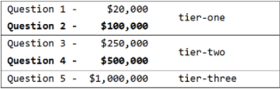

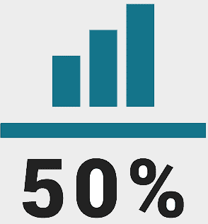
INTRODUCTION
Each question is set to have a specific money prize.
Forms of assistance known as "lifelines" are available for a contestant to use if a question proves difficult.

Slide 5
INTRODUCTION
Game Over Conditions
If the contestant correctly answers all the five consecutive multiple-choice questions, the game is over, and he/she has won the top prize.
If the contestant gives a wrong answer, the game is over. Contestants giving an incorrect answer see their winnings drop down to the last tier milestone achieved.
The contestant may choose to stop playing, the game is over. Choosing to stop allows the contestants to keep their money in the bank.

Slide 6






PROGRESS SUMMARY
REQUIREMENTS
Java Knowledge
Visual Studio Code
Eclipse
WhatsApp
Discord
Microsoft PowerPoint

Slide 7
PROGRESS SUMMARY
TASK SHARING
GÜRKAN BIYIK
BEDİRHAN KARAAHMETLİ
AHMET SALİH KARA
Statistics
Designing the screen
Word cloud
MEHMET MOLLAOĞLU
Designing the screen
Reading input files
Word cloud
Statistics
Spell check
Designing classes
Designing classes
Designing classes
Designing classes
Lifelines
Competition operations
Competition operations
Competition operations
Spell check

Slide 8
PROGRESS SUMMARY
SCHEDULE
1. Week:
Meeting with partner and analyzing project
Designing the screen
2. Week:
Word cloud
Designing classes
Reading input files
Spell check
Creating the necessary data structures.

Slide 9
PROGRESS SUMMARY
SCHEDULE
3. Week:
Lifelines
4. Week:
Additional improvement
Preparing presentation and video
Competition operations
Debugging
Statistics

Slide 10
PROGRESS SUMMARY
COMPLETED TASKS
Designing the screen
Reading input files
Spell check
Word cloud
Competition operations
Lifelines
Statistics
Designing classes

Slide 11

PROGRESS SUMMARY
INCOMPLETED TASKS
Everything is completed successfully.

Slide 12
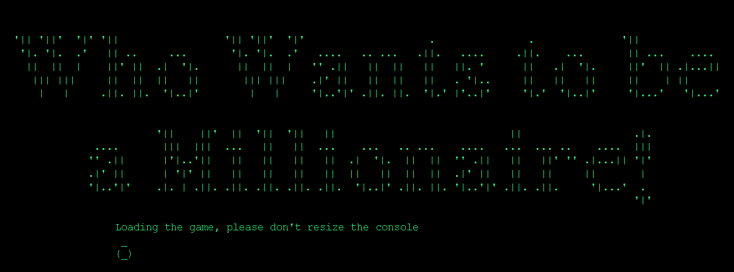
PROGRESS SUMMARY
ADDITIONAL IMPROVEMENT
Visual improvements added to the game
Randomized (Every game offers unique experience with randomized visuals and questions)
Totaly scalable and modifiable code

Slide 13


PROBLEMS ENCOUNTERED
When trying to print the number of questions in the categories on the screen, it did not appear properly due to the different lengths in the category names. Solved using the 'for' loop and considering the length of the category names.
Gürkan's computer broke down.
We didn't have much information about enigma library at first. We had to extract the jar file and examine the classes. A wrapper library was created in order to makenit easier to use.

Slide 14
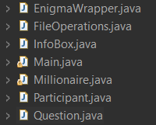
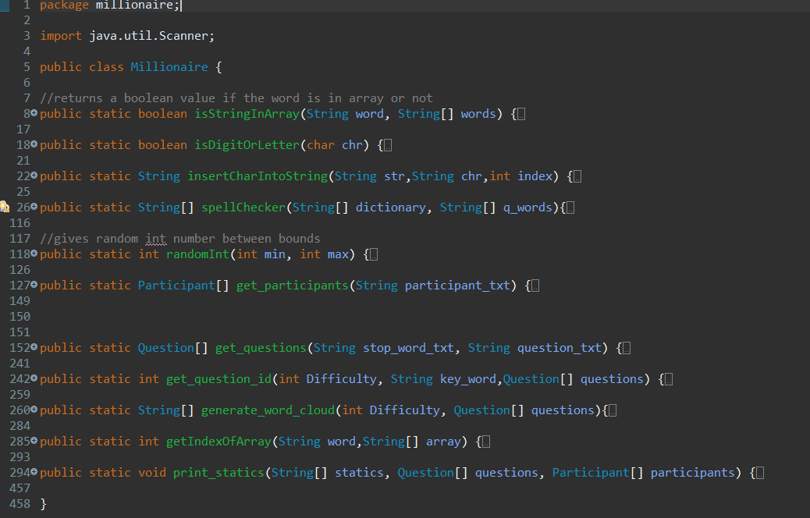
ALGORITHMS AND SOLUTION STRATEGIES

Slide 15
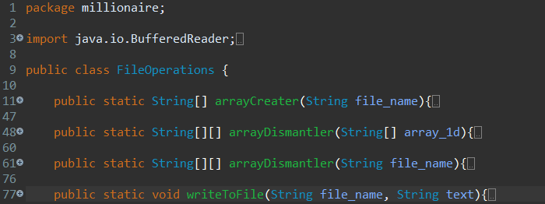
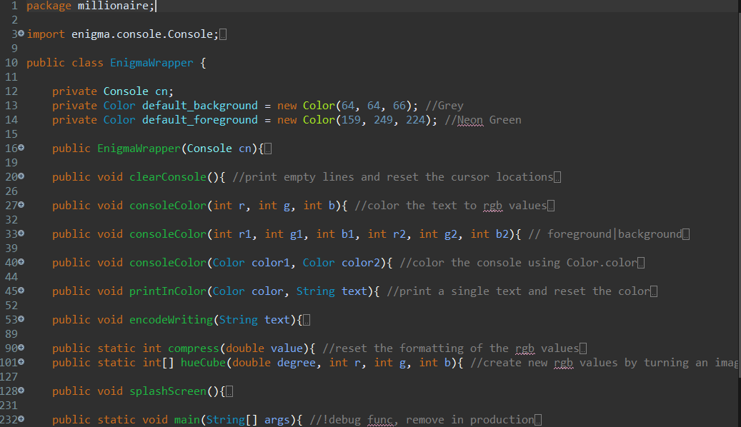
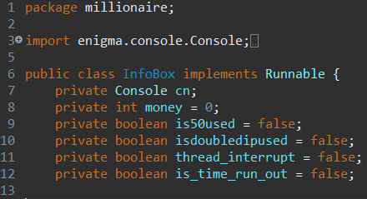

Slide 16
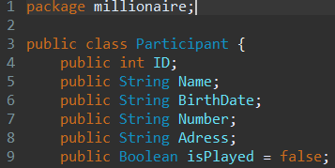
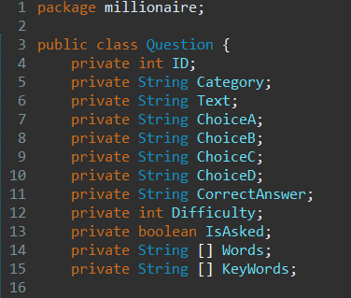

Slide 17
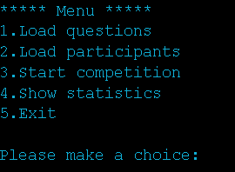
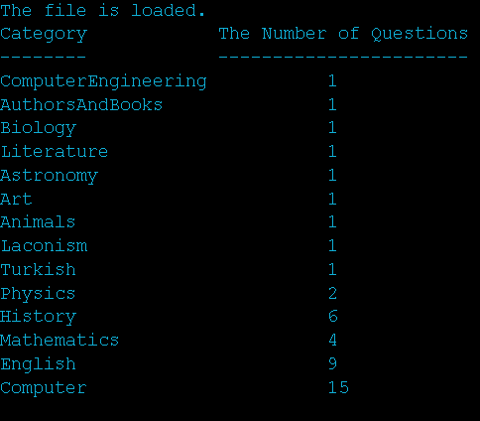
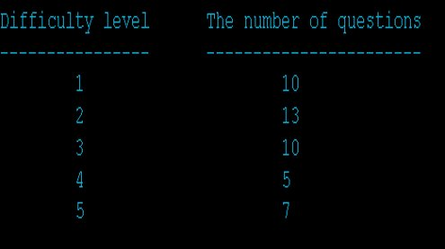
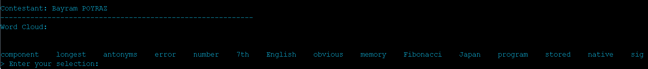
SCREENSHOTS

Slide 18
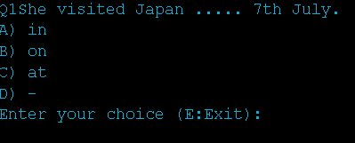
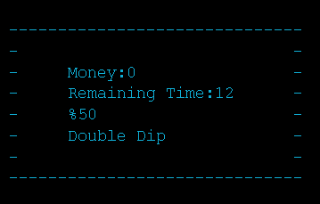
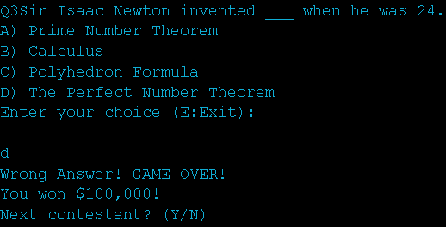
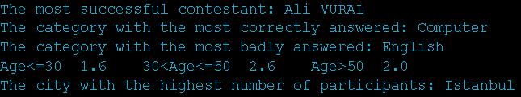
SCREENSHOTS

Slide 19

CONCLUSION
By developing this project, we learned :
Team Work
Usage Of Loops in Java
Usage Of Arrays in Java
Usage Of Functions in Java
Reading input files in Java
Designing Classes
Analytical Thinking
Managing Time

Slide 20
REFERENCES
https://www.javatpoint.com/
https://stackoverflow.com/
GeeksforGeeks | A computer science portal for geeks
https://www.w3schools.com/
https://github.com/mikepound/enigma

Slide 21
THANK YOU FOR YOUR TIME. ANY QUESTIONS ?

